Slide 1
Self-Aligned Double Patterning Aware Pin Access and Standard Cell Layout Co-Optimization
Presenter: Chien-Yi Yang
IEEE Trans. CAD, VOL. 34, MAY 2015
Xiaoqing Xu, Brian Cline, Greg Yeric, Bei Yu, and David Z. Pan
The Electronic Design Automation Laboratory
Graduate Institute of Electrical Engineering
National Taiwan University
Taipei 106, Taiwan

Slide 2
Outline
Introduction
Algorithms
Experimental Results
Conclusion

Slide 3
Outline
Introduction
Algorithms
Experimental Results
Conclusion

Slide 4
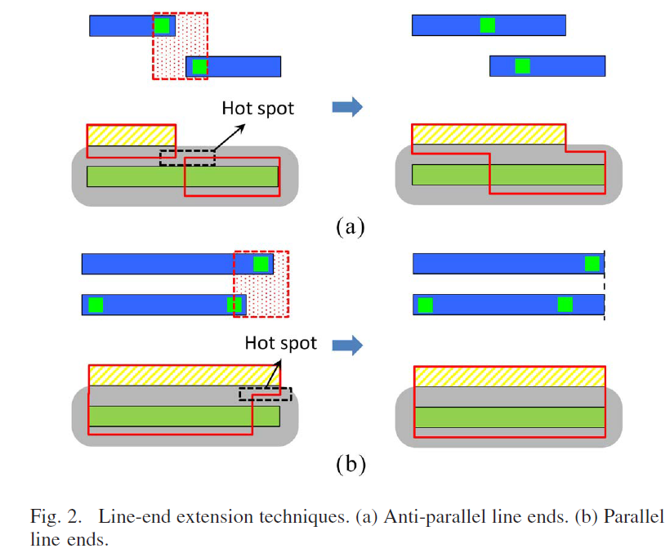
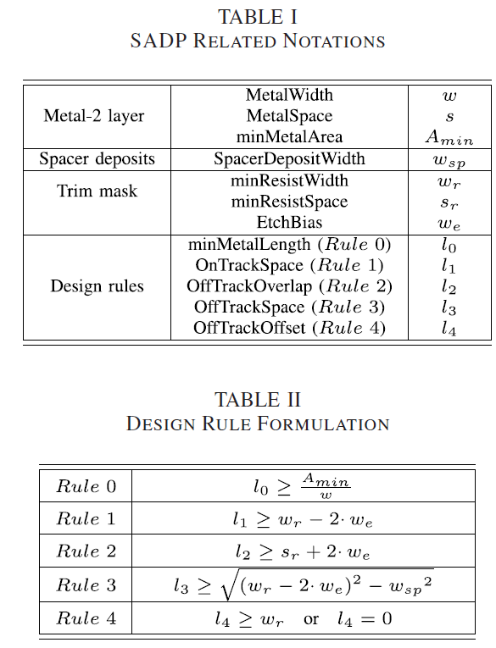
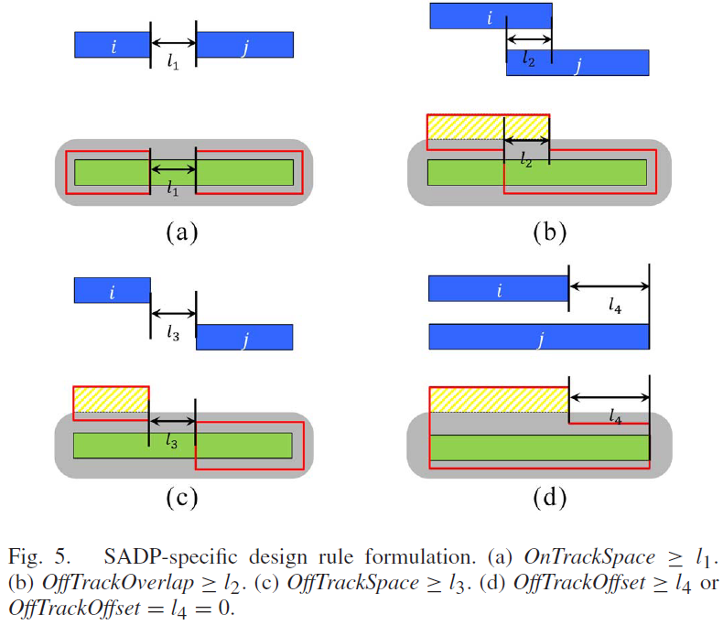
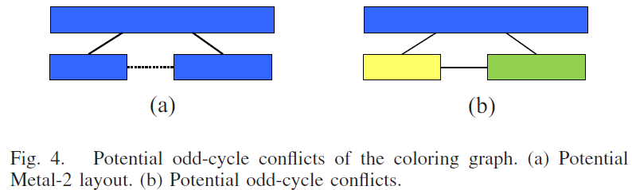
Design Rules

Slide 5
Definitions
Hit Point
The overlap of a Metal-2 routing track and an I/O pin shape
Hit Point Combination
A set of hit points where each I/O pin in the standard cell is accessed exactly once
Valid Hit Point Combination
Hit point combination which induces zero design rule violations
Valid Hit Point
A hit point which can be accessed from both directions within some valid hit point combinations for one cell

Slide 6
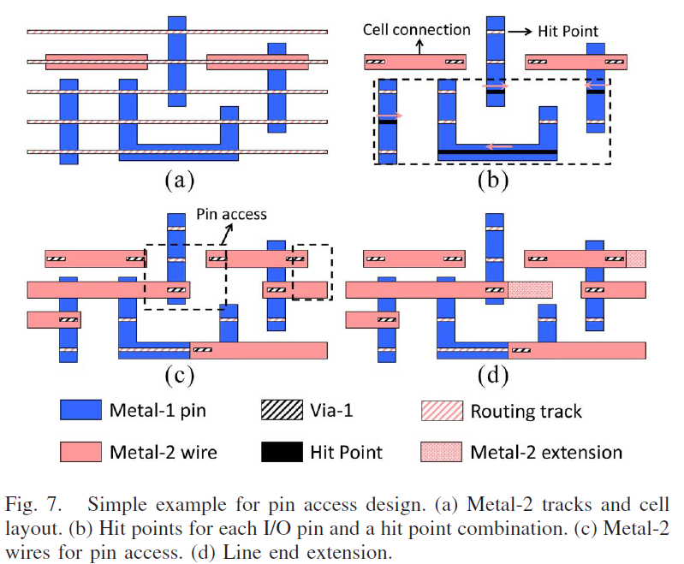
Definitions

Slide 7
Problem Formulation
Problem 1: Pin Access Optimization (PAO)
Given the SC layout and a specific hit point combination, determine whether or not it is possible to achieve an optimal LELE-friendly Via-1 assignment and subsequently optimize the Metal-2 wires for pin access and within-cell connections given the Via-1 assignment under SADP constraints. If possible, show legal Via-1 assignment and all SADP-friendly Metal-2 wires.
Problem 2: Pin Access and Cell Layout Co-Optimization (PICO)
Given the SC layout, show all Via-1 assignment and Metal-2 wiring cases with successful PAOs and maximize the pin access flexibility under LELE and SADP constraints.

Slide 8
Outline
Introduction
Algorithms
Proposed Flow
Dynamic IR drop prediction
Dynamic IR drop aware cell movement
Experimental Results
Conclusion

Slide 9
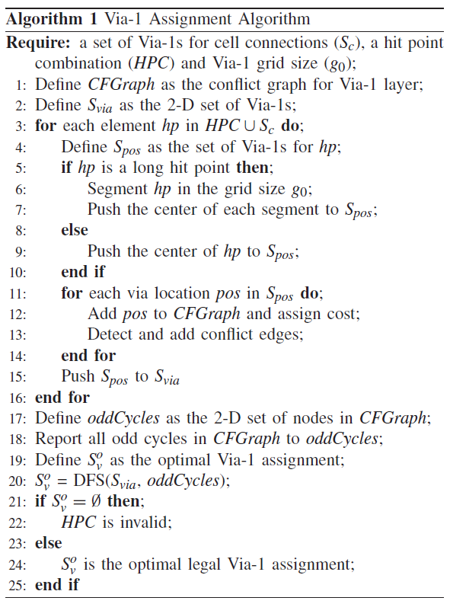
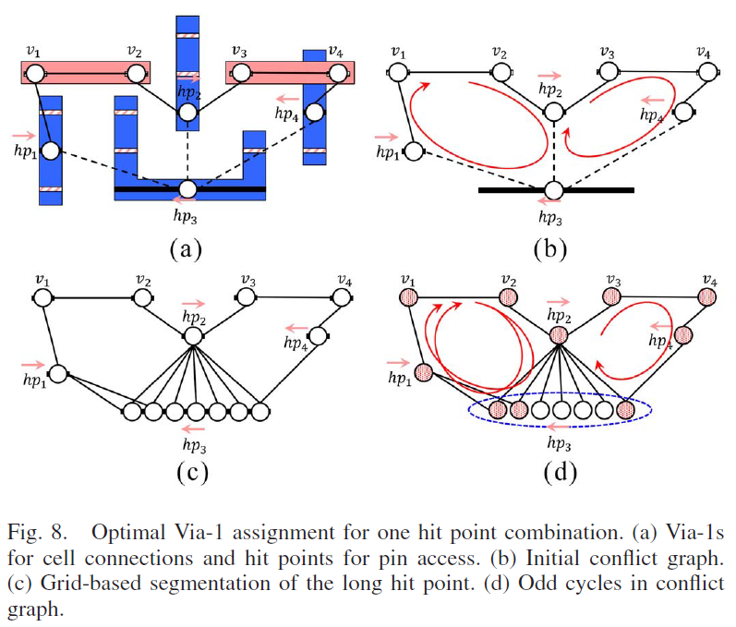

LELE-Aware Via-1 Assignment (PAO)
Takes O($k^{n}$)
k is the number of candidates of a hit point
n and k are often bounded

Slide 10
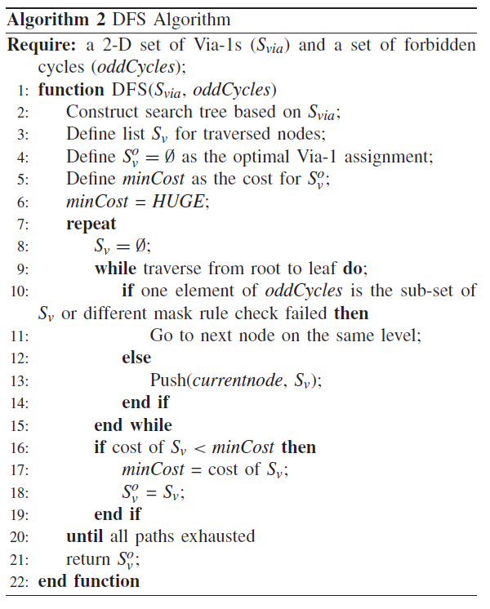
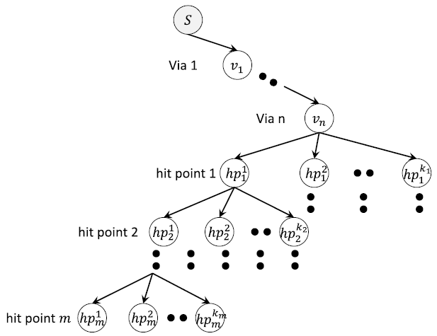
LELE-Aware Via-1 Assignment (PAO)
Construct Search Tree

Slide 11
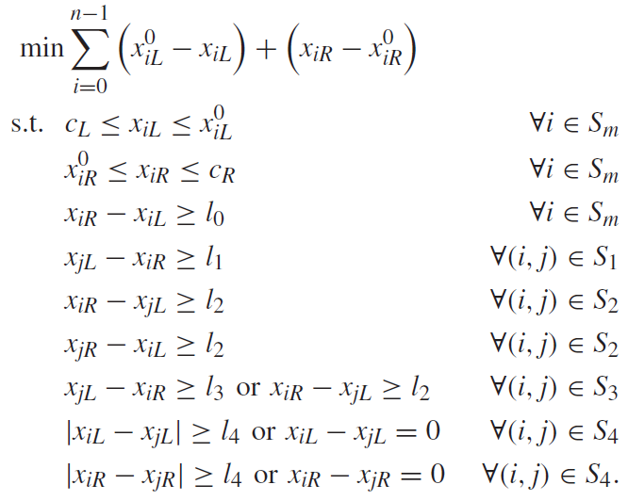
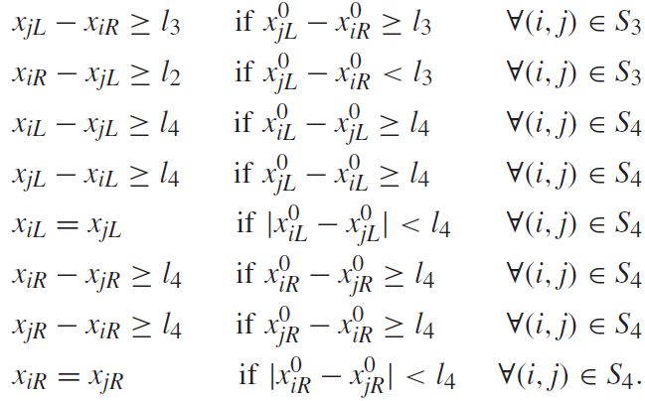
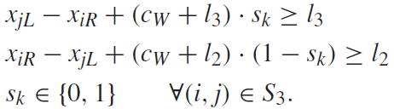
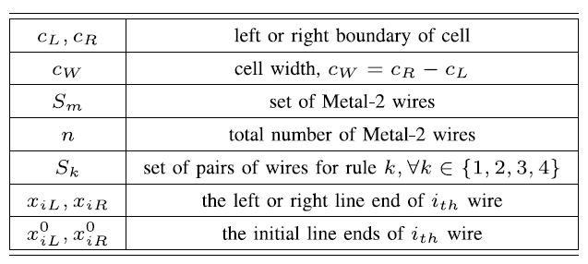
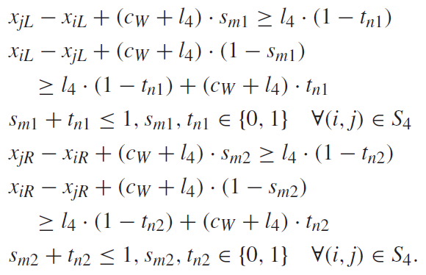
SAPD-Aware Pin Access
Mathematical Formulation
MILP Formulation
Lagrangian Relaxation

Slide 12
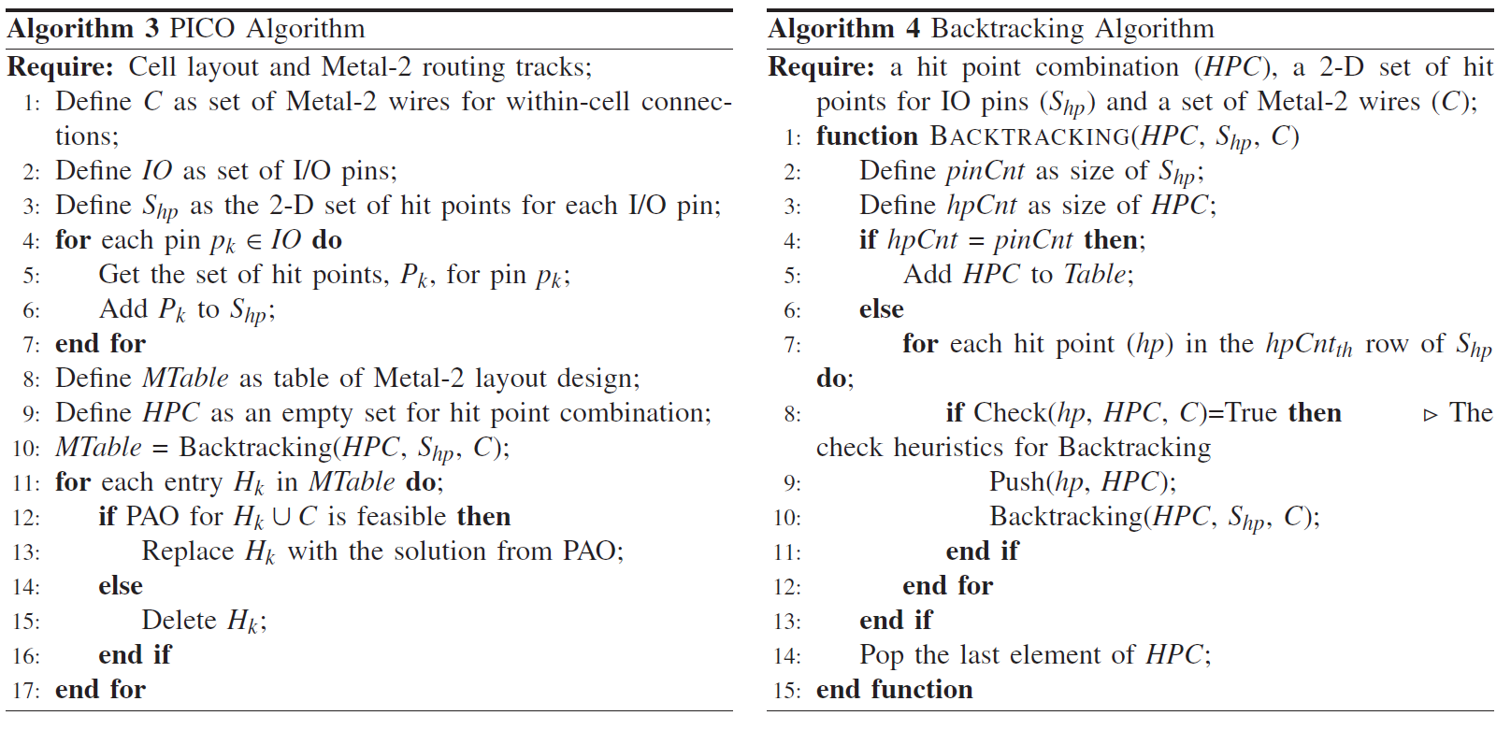
PICO

Slide 13
Outline
Introduction
Problem Formulation
Experimental Results
Conclusion

Slide 14
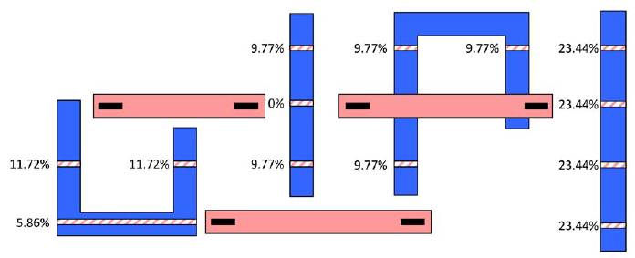
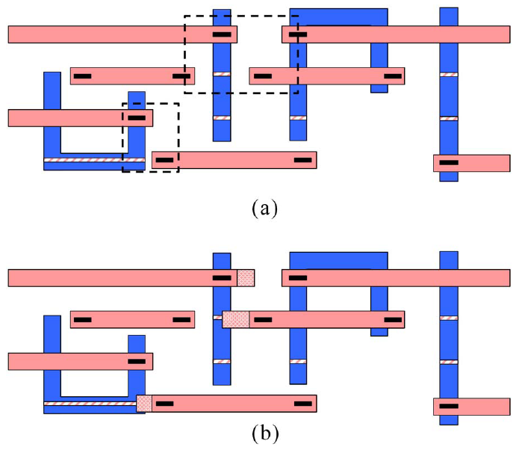
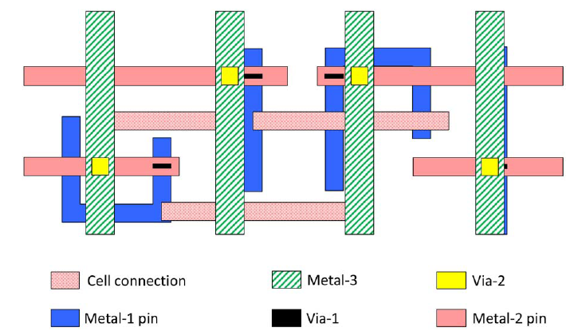
Experimental Results

Slide 15
Outline
Introduction
Algorithms
Experimental Results
Conclusion

Slide 16
Conclusion
Proposes propose a systematic methodology and introduce two algorithms, PAO for a specific I/O hit point combination and PICO for a SC
Future Work: extend the PAO technique to the intercell pin access study considering placement level information

Slide 17

Thank You!

